Slide 1


Organisation of the nervous system: Nerves and cells and structure
Vincenzo Mastrolia
Research Associate
Centre for Developmental Neurobiology (CDN)
King’s College London

Slide 2
Learning outcomes
Define the divisions of the nervous system
Define the terminology used for different parts of the brain and meninges
Explain what is meant by neurones and neuroglia and give an account of their main features and functions
Describe the basic arrangement of motor and sensory nerves
Give an account of the organisation of nerve and neural connective tissues
Explain the classification schemes for nerves
Explain the range of sensory receptors, each with a precise function

Slide 3
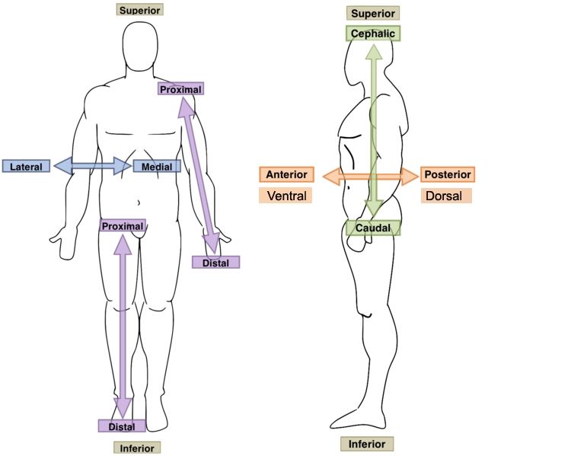
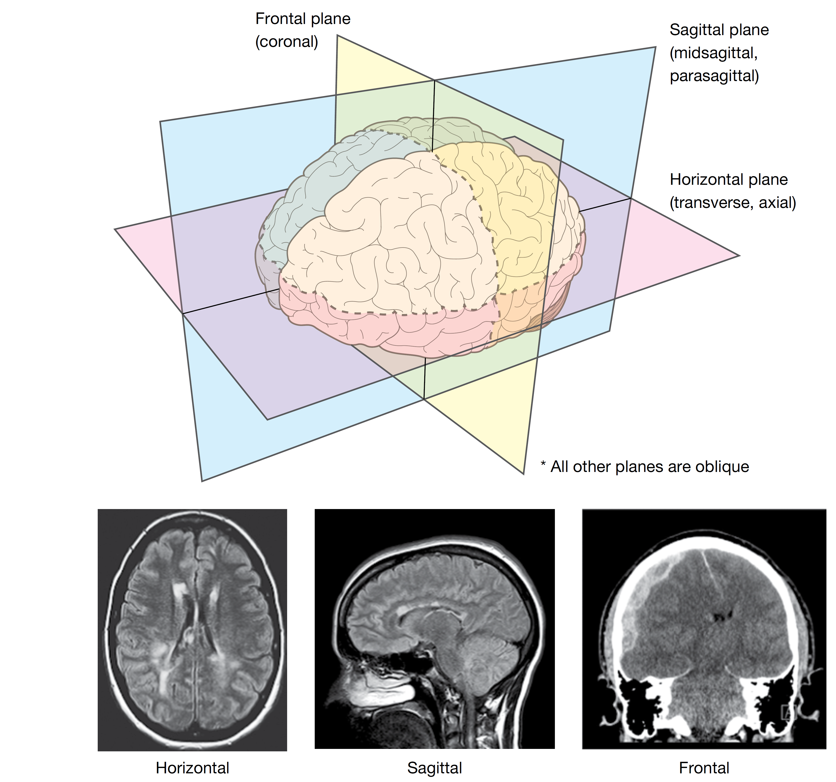
Anatomical orientation

Slide 4
Gross Anatomy of the nervous system

Slide 5
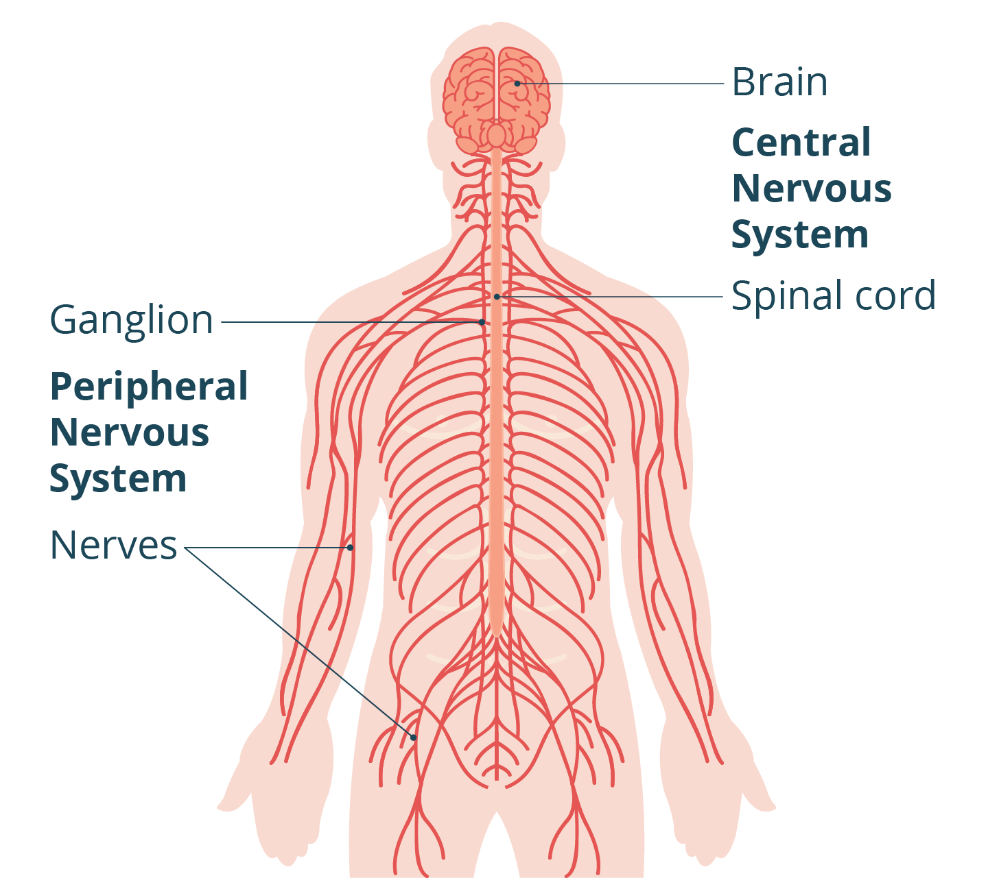
The nervous system

Slide 6
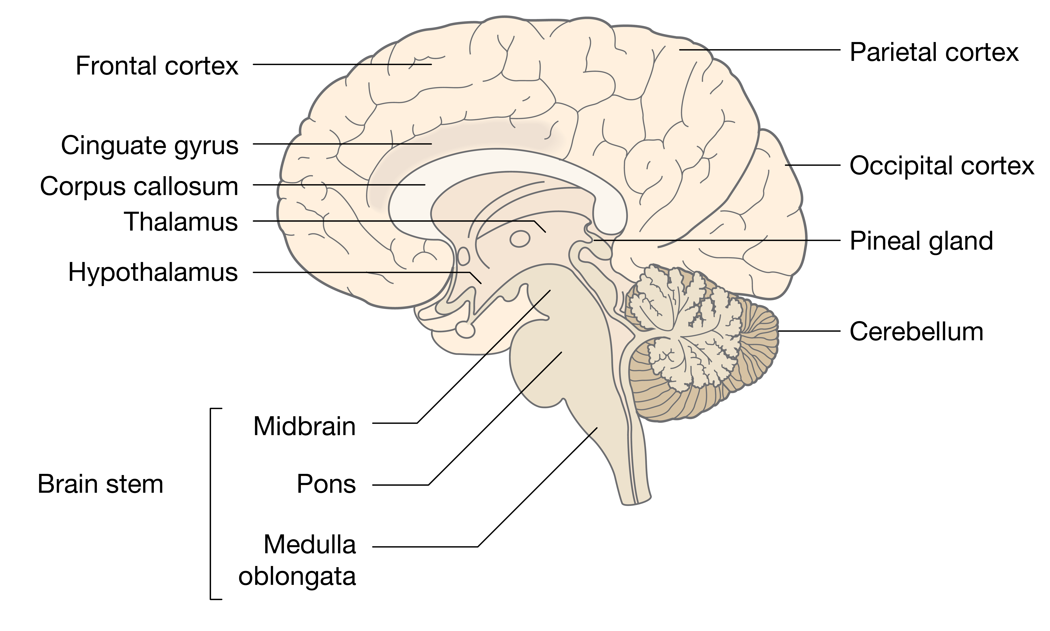
The CNS - Brain

Slide 7
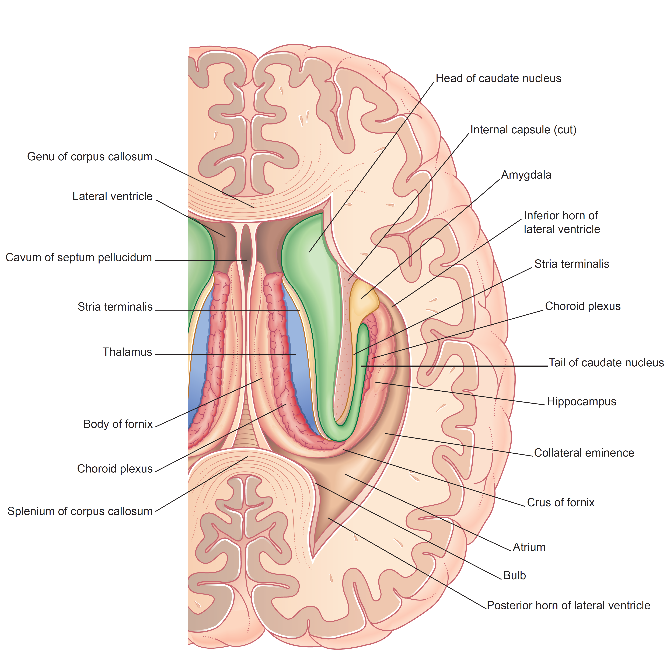
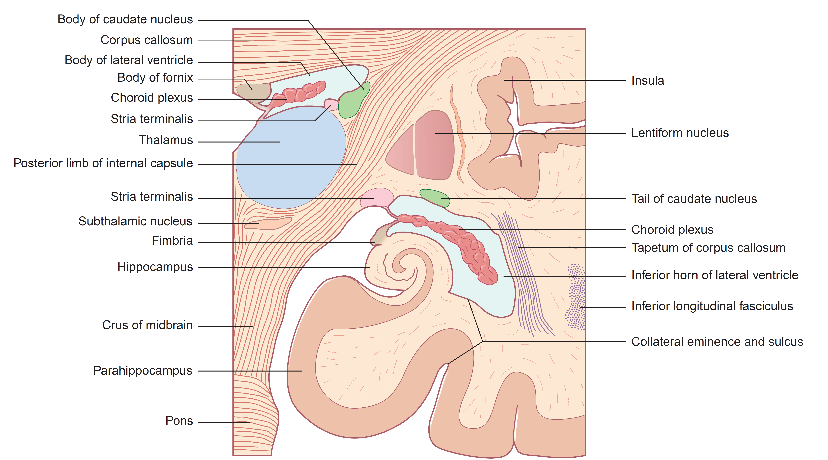
The CNS - Brain

Slide 8
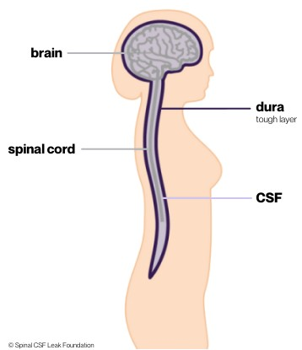
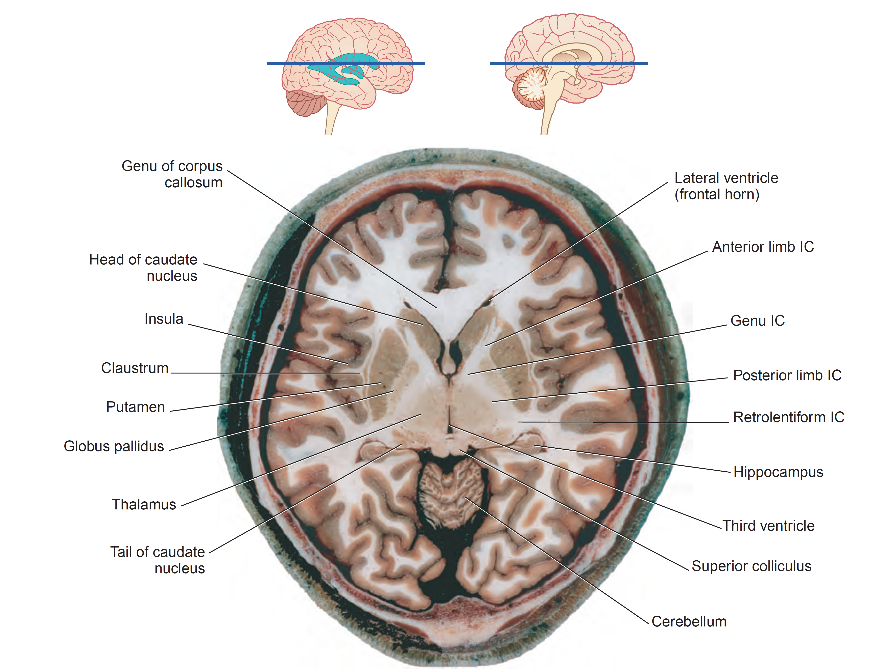
The ventricles and the CSF
CSF = Cerebrospinal fluid

Slide 9
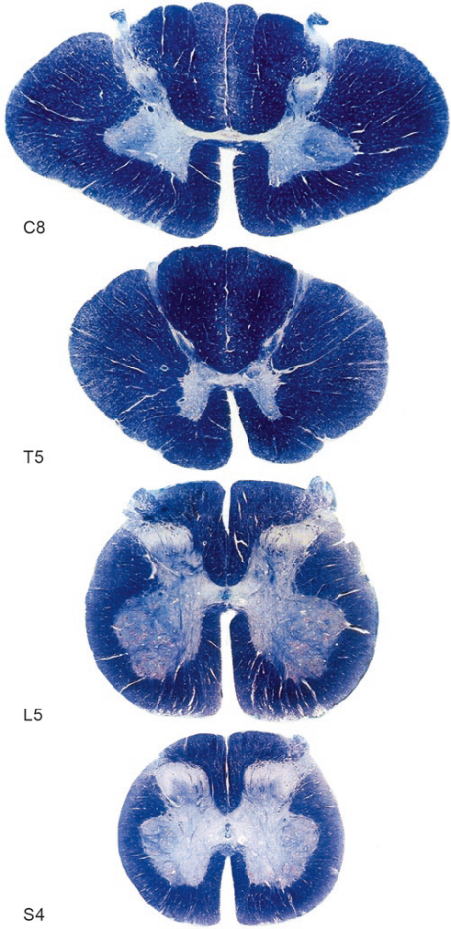
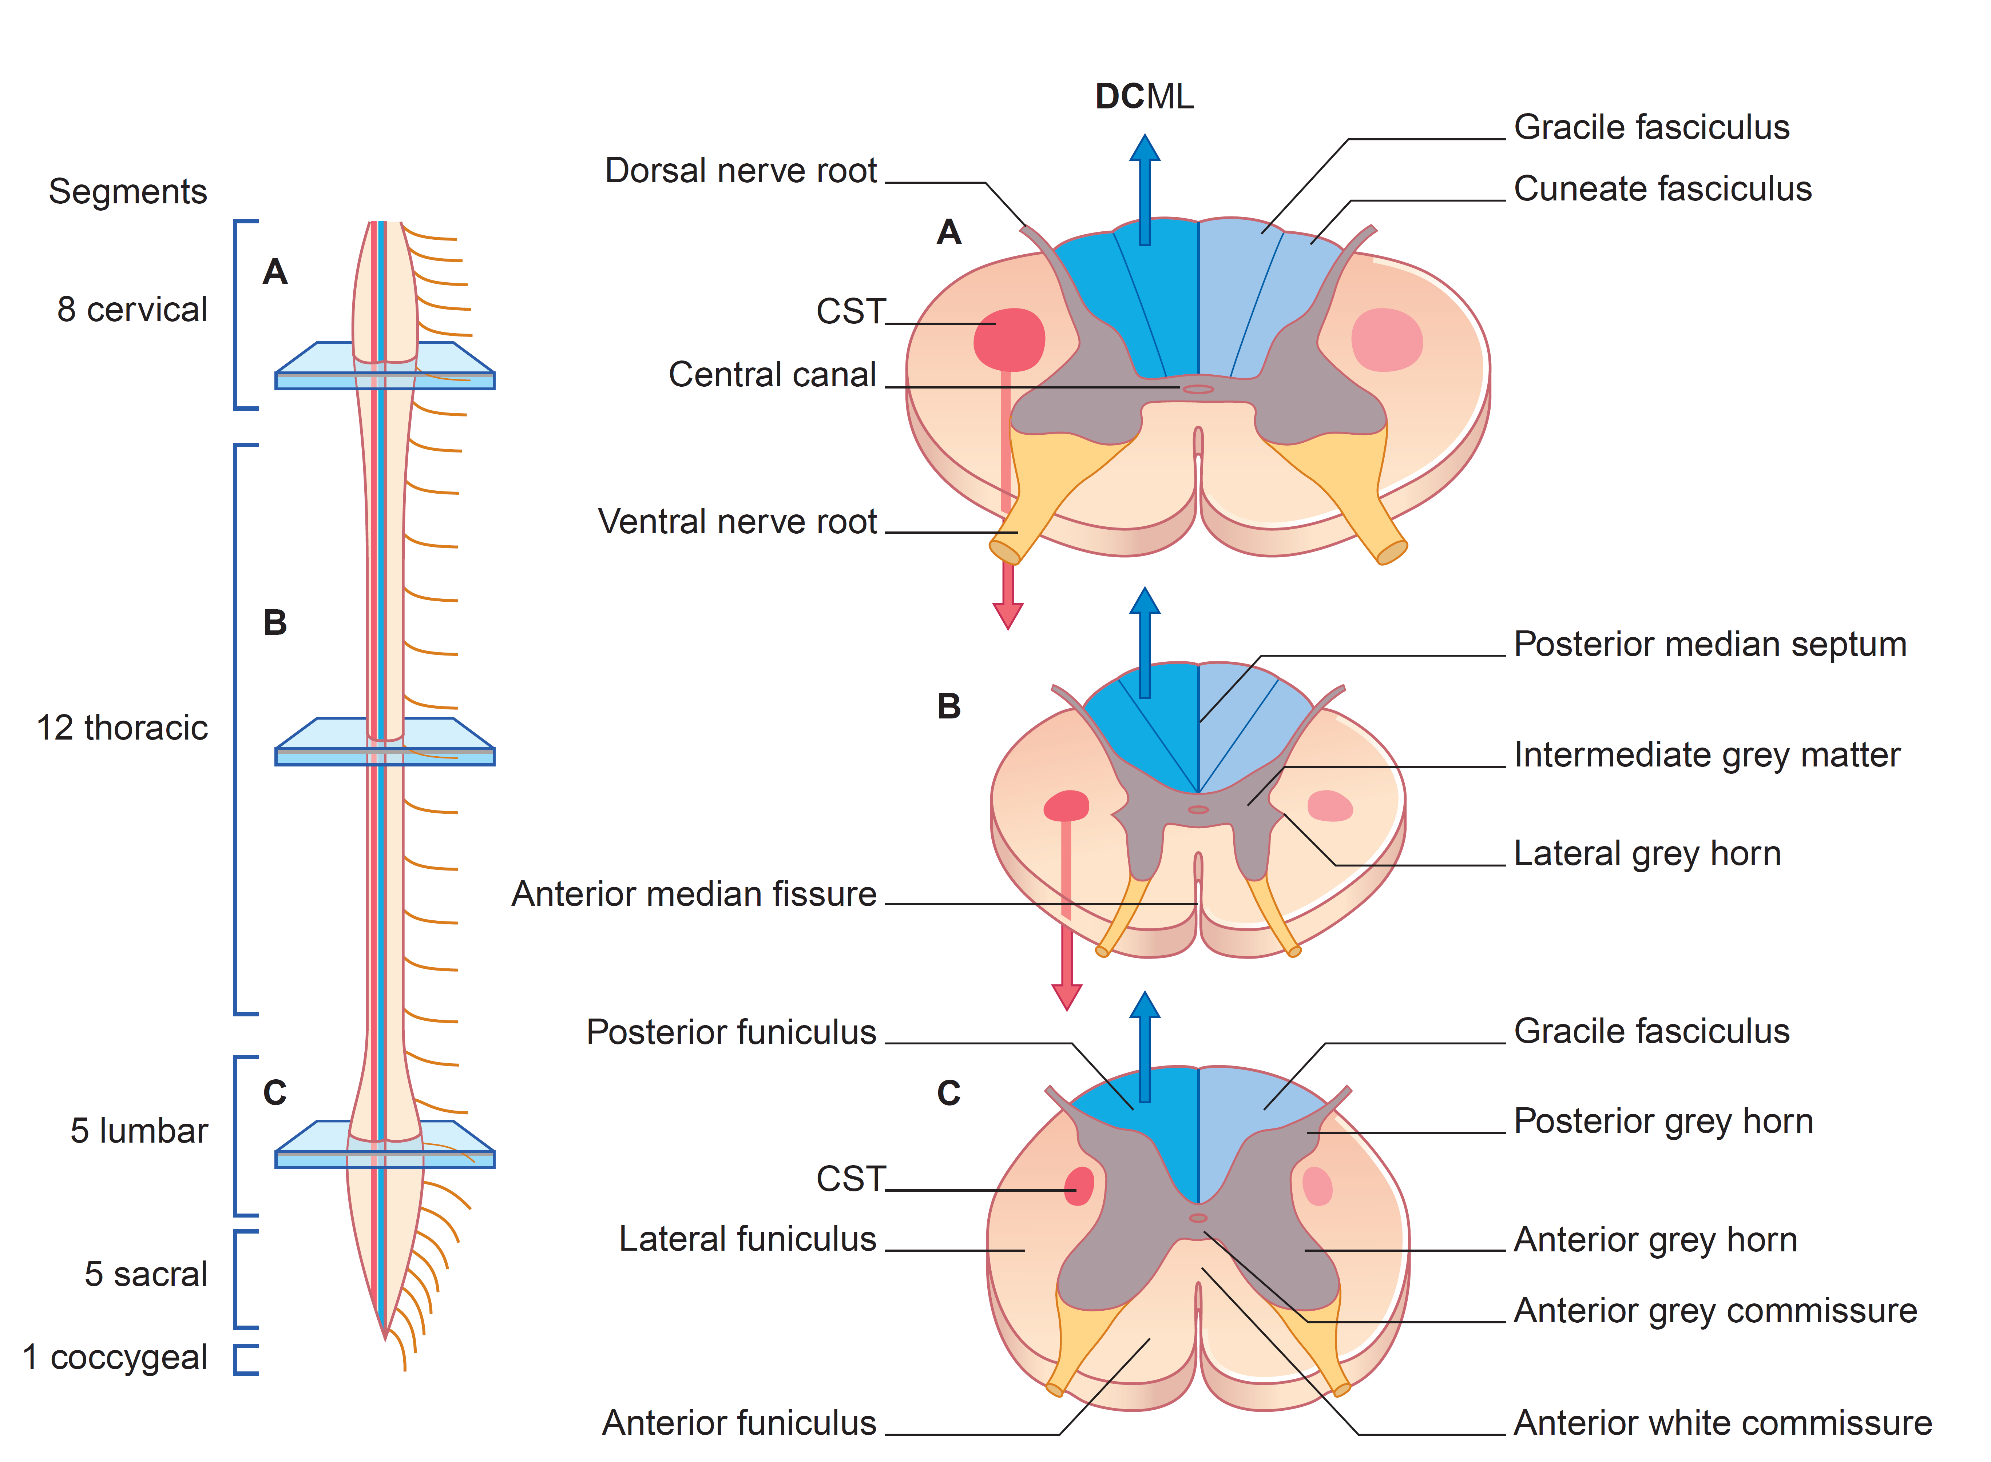
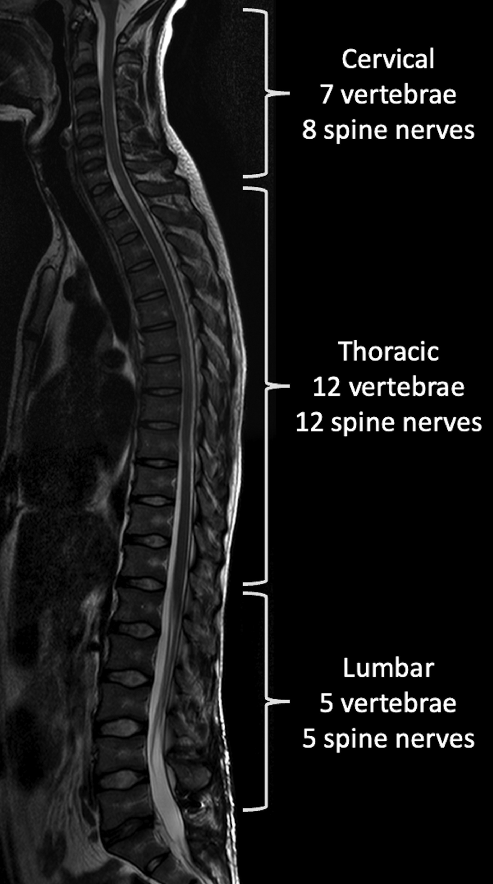
The CNS - Spinal Cord

Slide 10
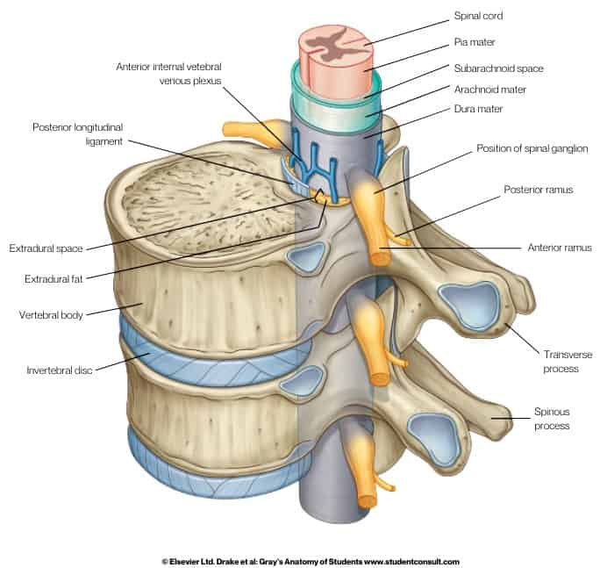
Meninges
Layers from inside to outside:
Pia mater
Subarachnoid space
Arachnoid
Dura mater

Slide 11
Cells of the nervous system

Slide 12
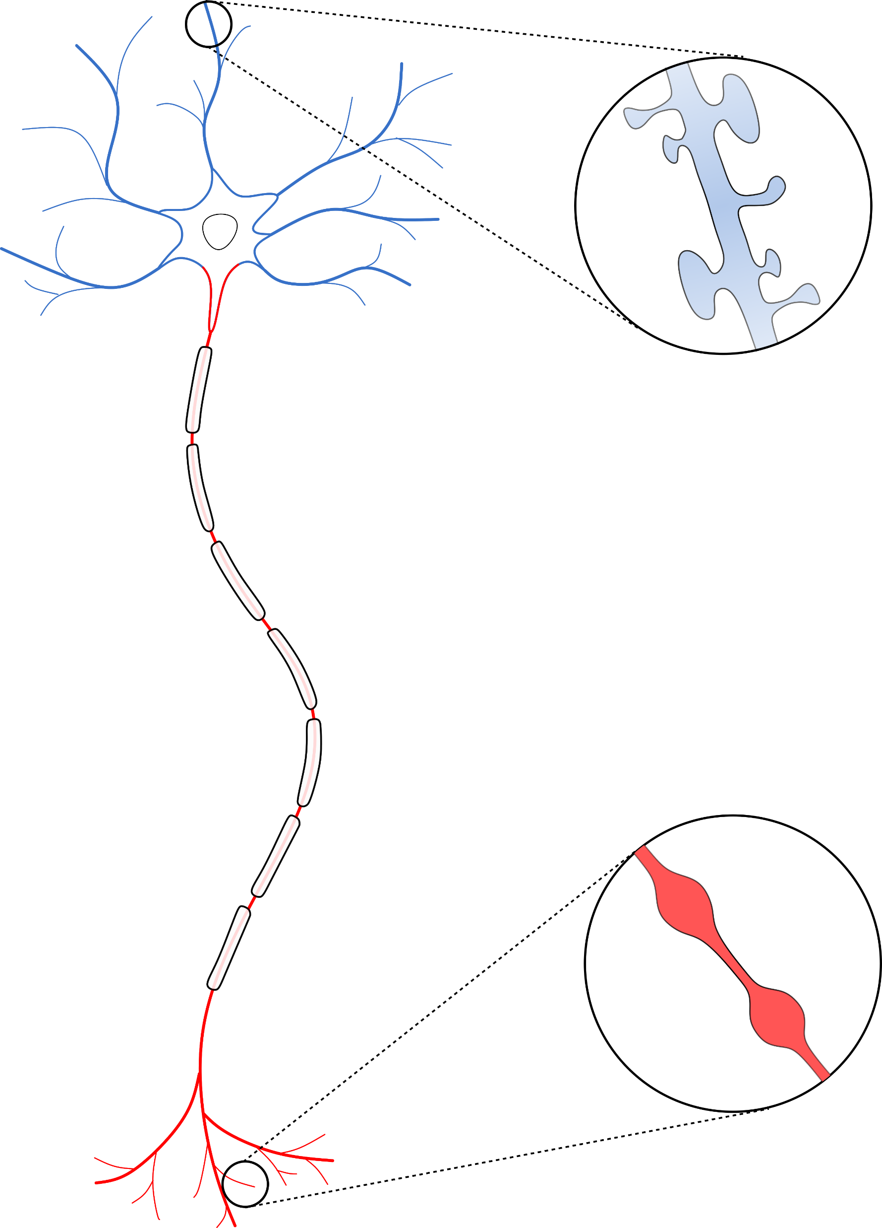

Cells of the nervous system - Neurons
Ability to process multiple inputs into an output
Specialized morphology
  Multitude of inputs → Dendrites
  Output → Axon
  Input neuron or target neuron can be very distant (projecting)
Excitable
  Voltage-/Ligand-gated ion channels
  Fast conduction of signals (myelin)
Axon
Initial Segment (AIS)
Dendritic
Spines
Nodes of
Ranvier
Myelin sheaths
Axonal Boutons
Terminals

Slide 13
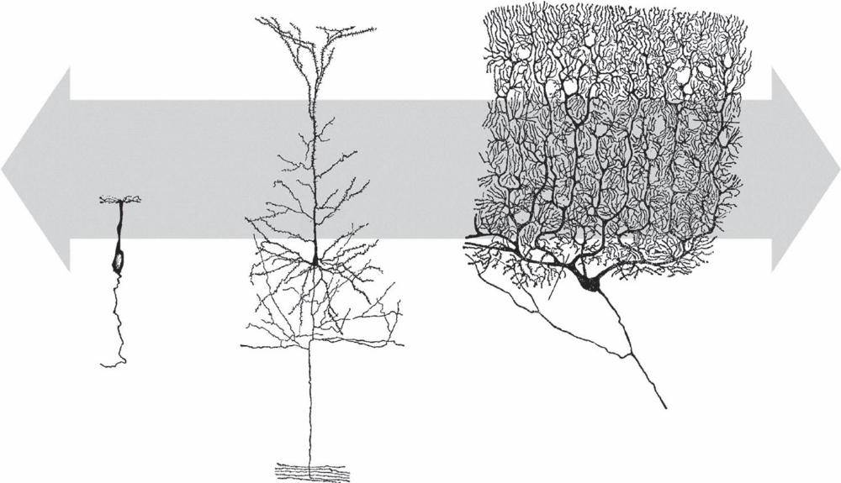
Neuronal-specific dendritic morphology
Selecting
Sampling
Space-filling
Olfactory sensory cell
Cerebellar Purkinje cell
Pyramidal cell
Dendrites organize in a dendritic arbour which is optimized to the tissue and inputs the neuron receives
Greg Stuart, Nelson Spruston, Michael Häusser - Dendrites (2016, Oxford University Press)

Slide 14

Types of neurons based on their output
Neurotransmitters
released
Activating
Inhibiting
Glutamate
(CNS)
Acetylcholine
(PNS)
GABA
(CNS)
Glycine
(PNS)

Slide 15
Types of neurons based on their output
Distance of projections
Local
Long-projecting
Pyramidal neurons
(CNS)
Interneurons
(PNS)
Interneurons
(CNS & PNS)
Pyramidal neurons
(CNS)
Sensory neurons
(PNS)
Motor neurons
(CNS & PNS)
Interneurons
(CNS & PNS)

Slide 16
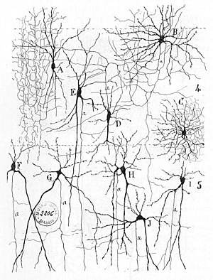
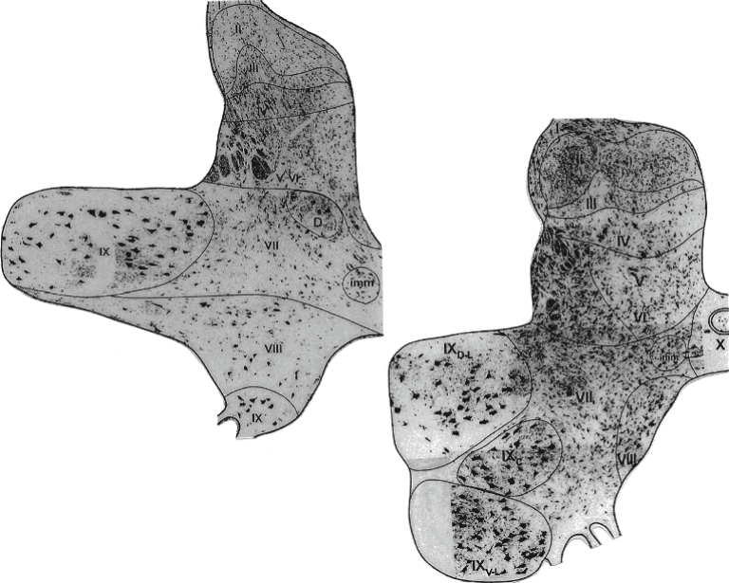
Neuronal networks
Highly specialized organization, depending on brain area
Specific neuronal distribution
  Brain cortex has 6 layers
  Spinal cord has 10 laminae

Slide 17
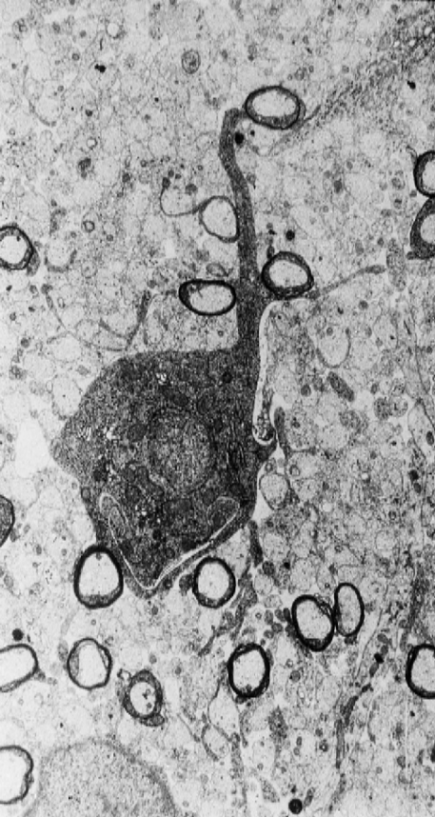
Cells of the nervous system - Oligodendrocytes

Slide 18
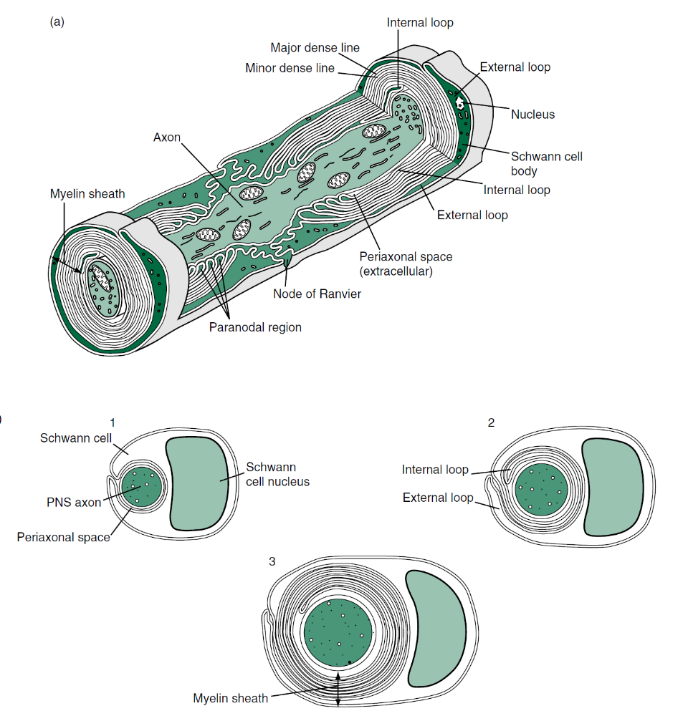
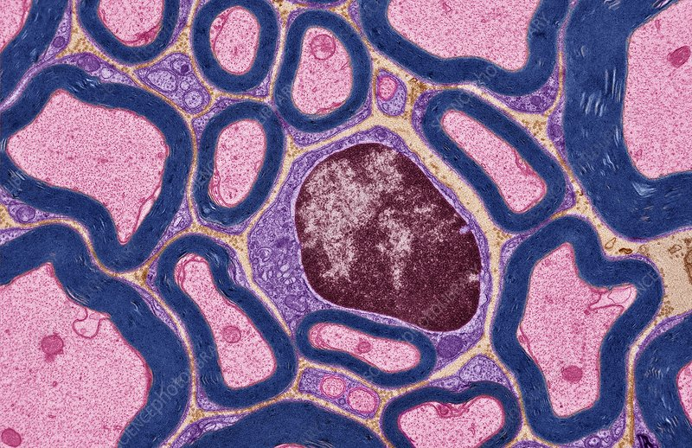
Cells of the nervous system - Schwann Cells

Slide 19
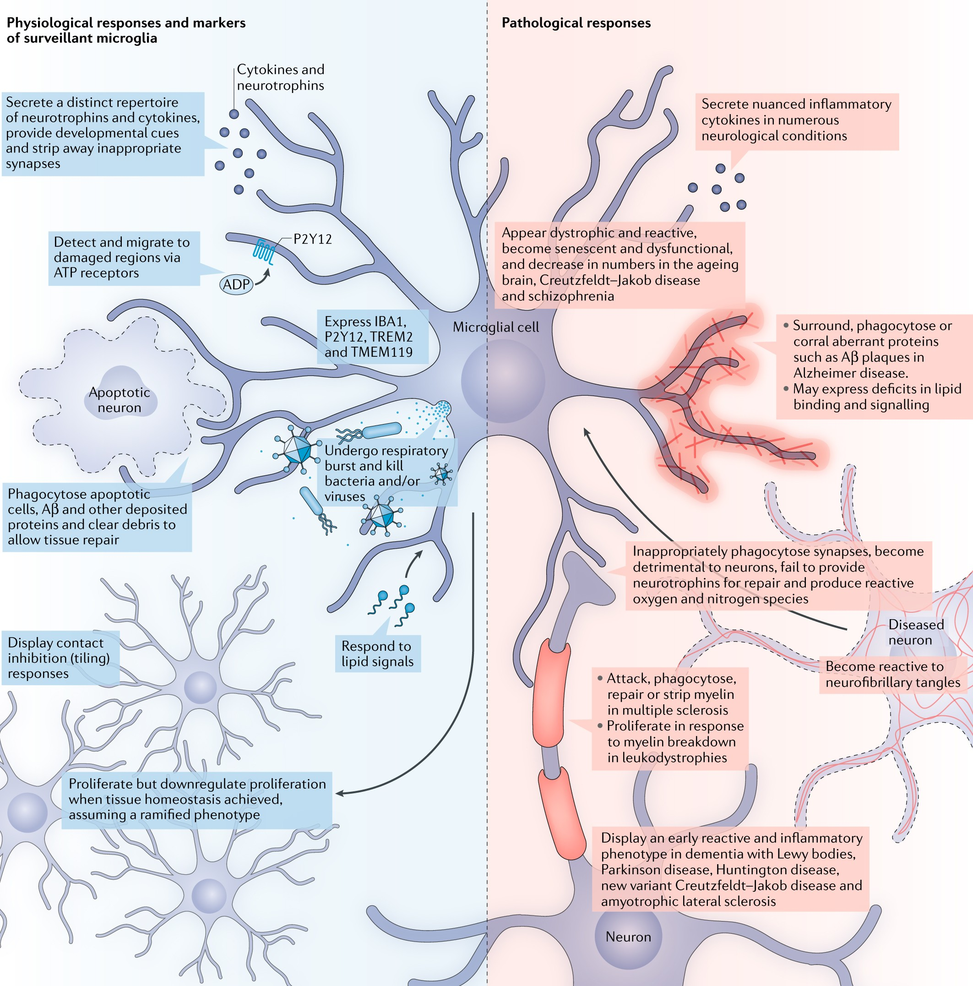
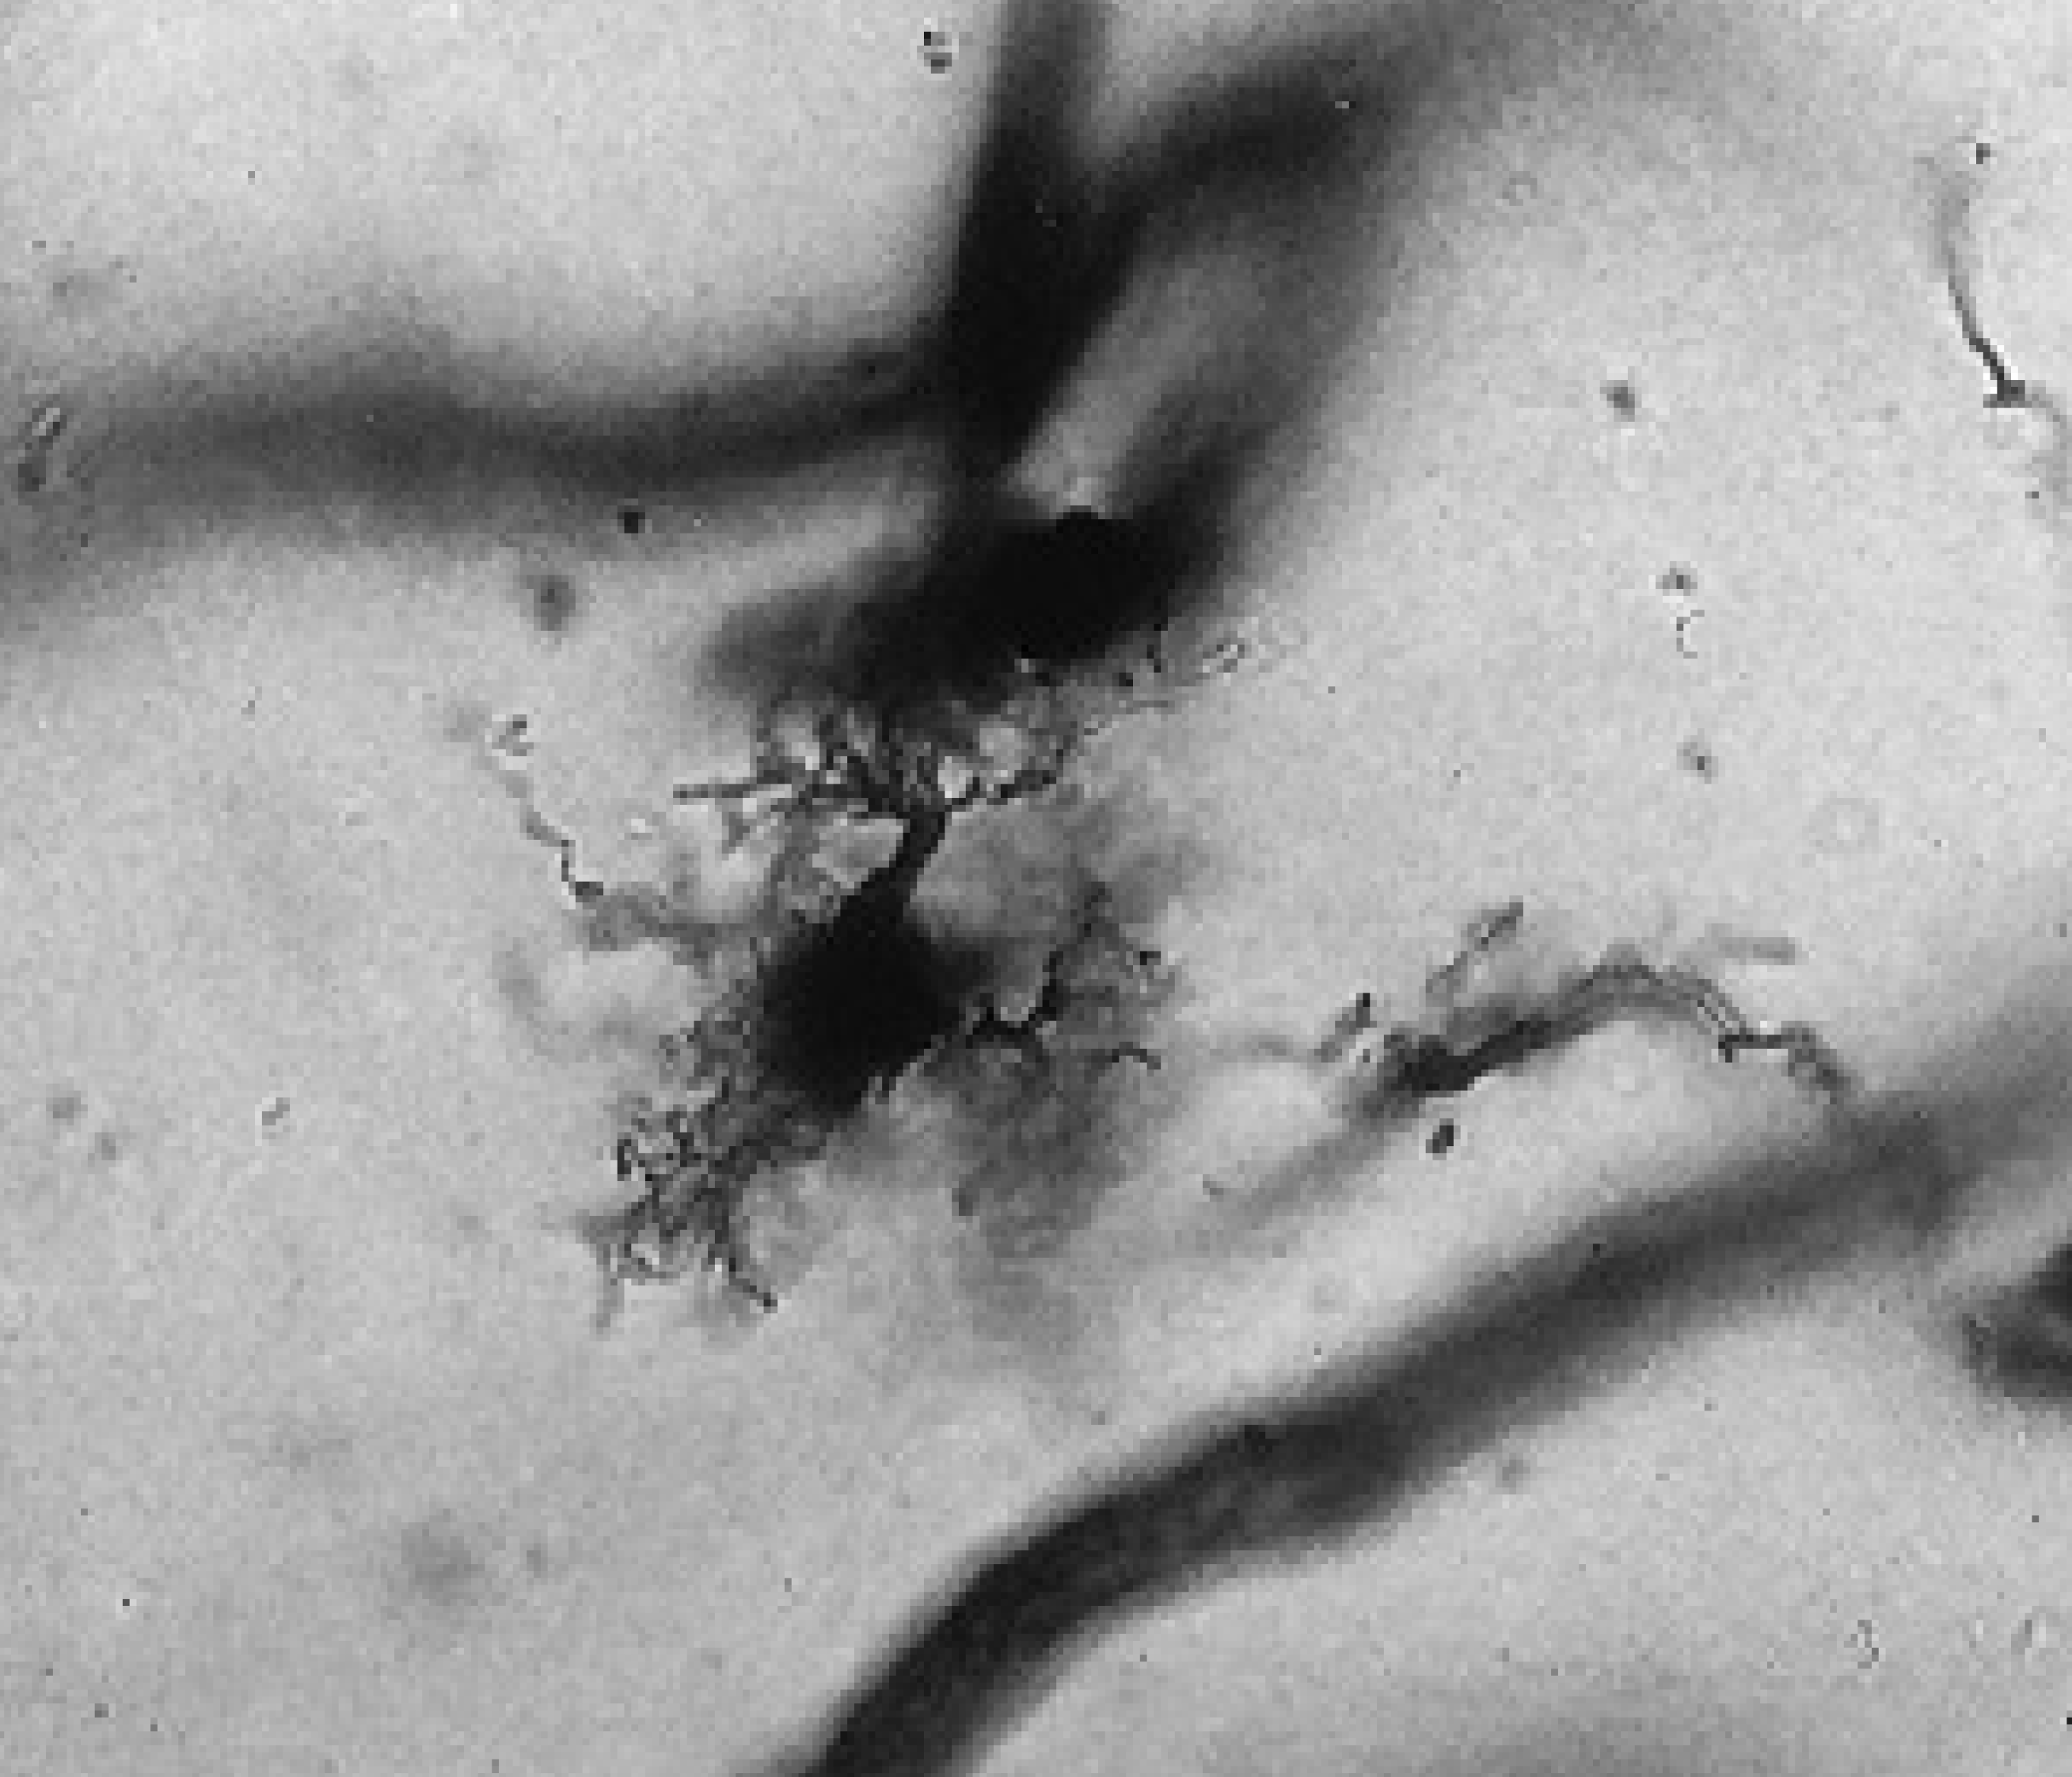
Cells of the nervous system - Microglia
Resident immune cells of the nervous system
Sentinel/physiological role in surveillance of the nervous tissue
Role in neuronal development and synapse refinement
Similar to macrophages (belonging to the myeloid lineage)
Can be activated during neuronal damage and inflammation (e.g. Alzheimer’s disease)

Slide 20
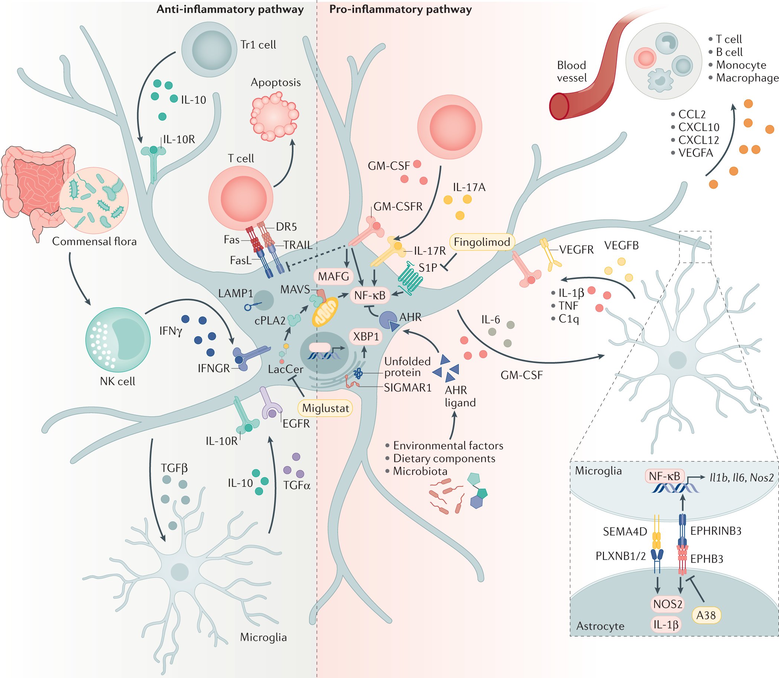
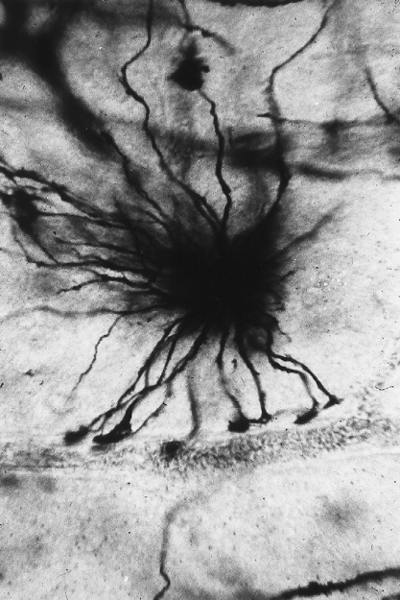
Cells of the nervous system - Astrocytes
Support cells for the neurons
Form the blood brain barrier
  Delivery of nutrients to the neurons
  Limited access from the bloodstream
Interact with synapses
  Modulation of synaptic transmission
Influences in inflammatory situations
  Neurodegenerative diseases

Slide 21
Neurons and glia
Glial cells
  Astrocytes
  Oligodendrocytes/Schwann cells
  Microglia
  Ependymal cells
  Radial glia
Interaction between neurons and the glial cells is essential to the physiology of the nervous system

Slide 22
Brain and Spinal Cord: Grey vs white matter
White Matter
Neuronal projections
Myelin
Glial cells
Grey Matter
Neuronal cell bodies
Glial cells

Slide 23
White matter in the brain: projections

Slide 24
The spinal cord and the nerves

Slide 25
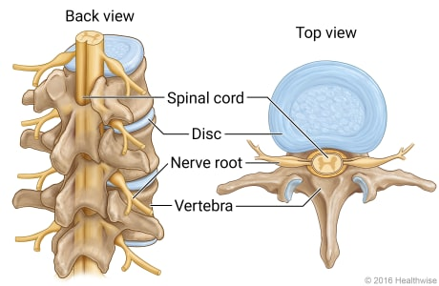
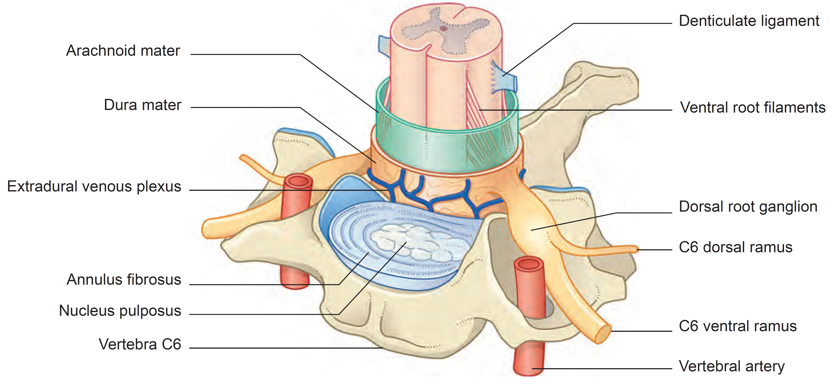
The spinal cord and the nerves

Slide 26
The spinal cord and the nerves

Slide 27
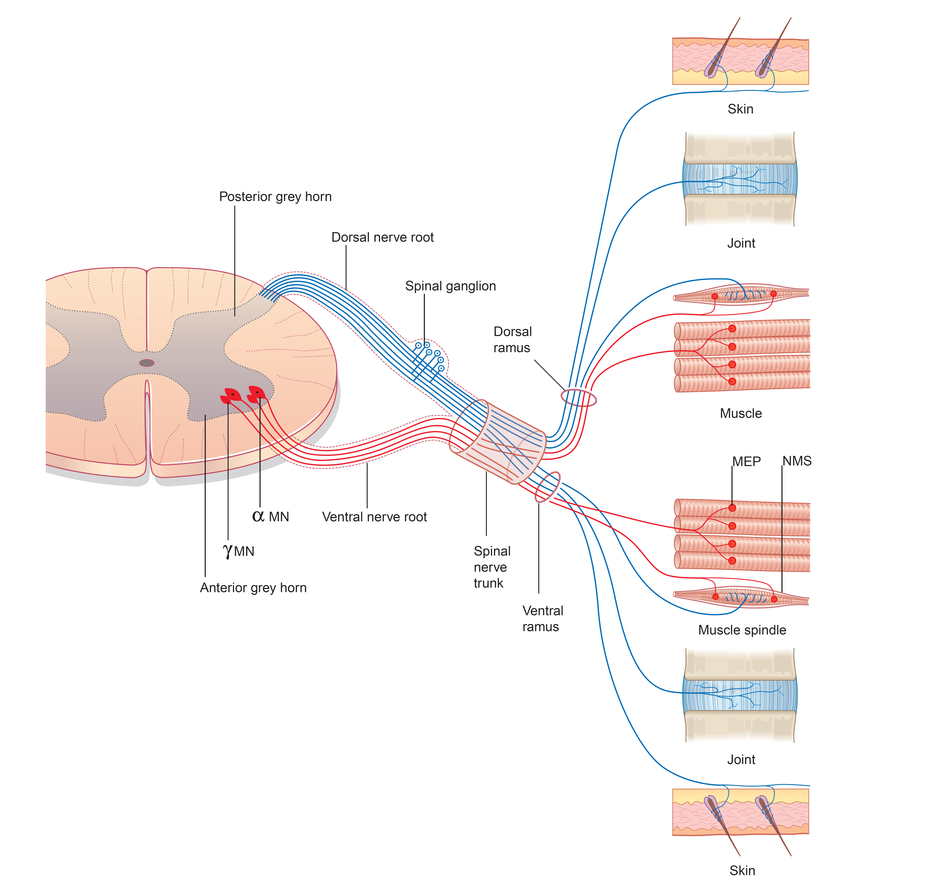
Nerve conduction

Slide 28

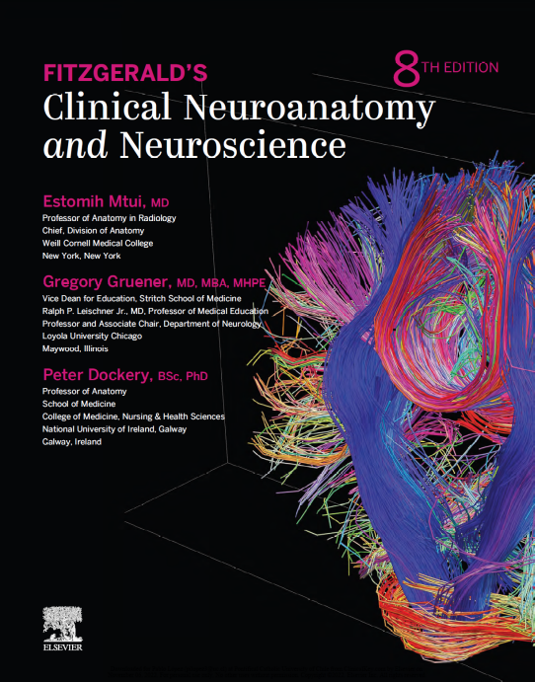
Questions?
For follow-up questions:
vincenzo.mastrolia@kcl.ac.uk
Specific reading:
  Guyton and Hall - Textbook of Medical Physiology 12th ed (2011) ISBN: 978-0-8089-2400-5
  Fitzgerald's Clinical Neuroanatomy and neuroscience 8th ed (2021, Elsevier) ISBN: 9780702079092

